Slide 1

Group 4
Costume Design Management
Notes:
http://fashion2apparel.blogspot.com/2017/10/important-fashion-design-tools.html

Slide 2
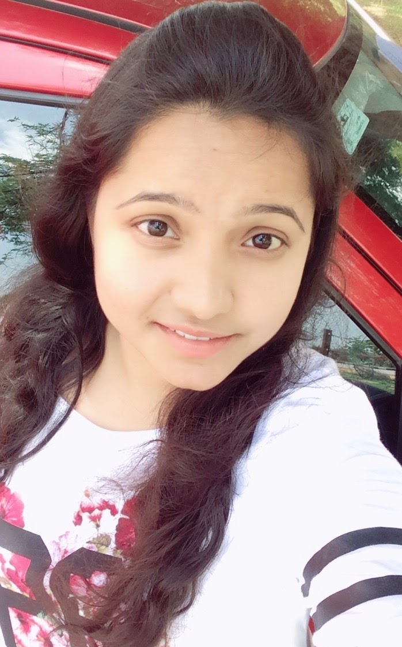
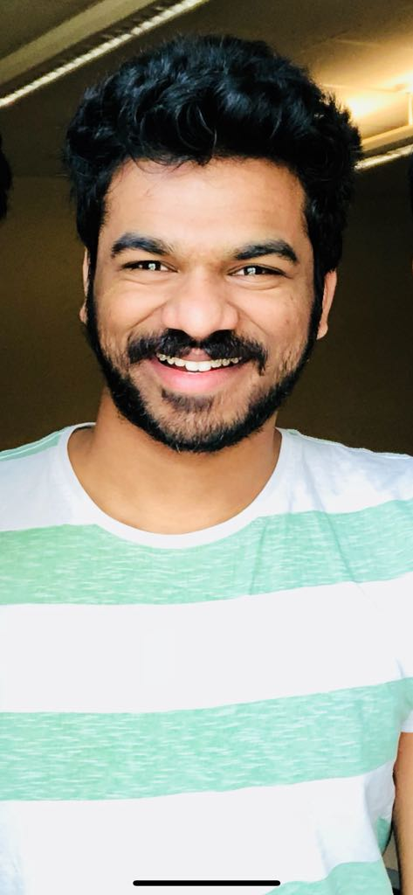


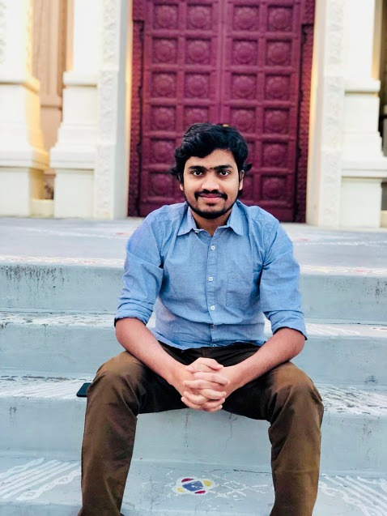
Team members:
Meghana Mayaluri Naveen Puvvada Siva Sai Nadipeneni Akhil Ravipati Shiva Mutukula

Slide 3
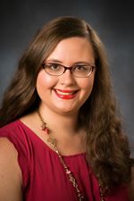
Client
Name: Stephanie Jorandby
Works at: Assistant Professor of Theatre/Costume at Northwest
Email id : stephi@nwmissouri.edu
Contact number: 660.562.1503

Slide 4
Contents
Problem Statement
Functional Requirements
Use Cases
Architecture diagram/plan
Security plans
Prototype demos
Conclusion

Slide 5
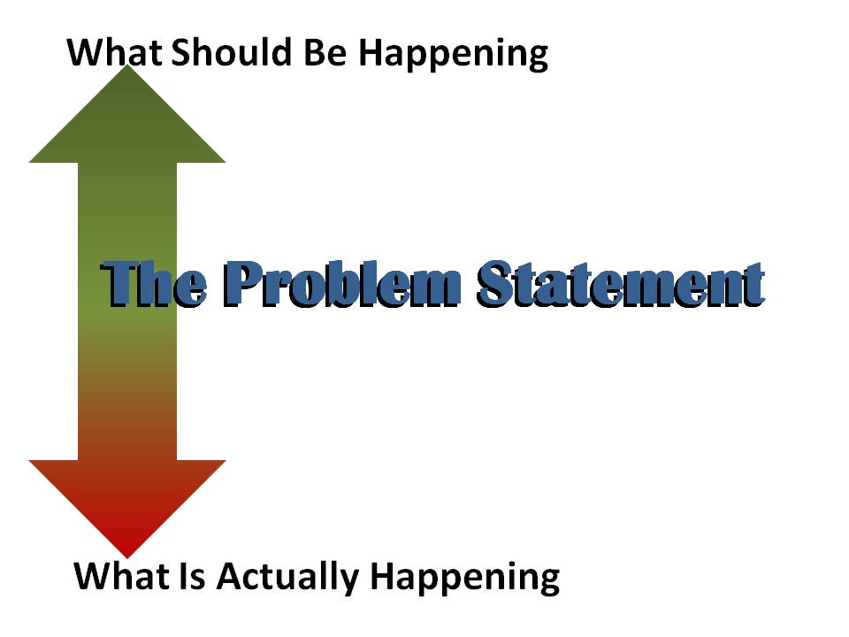

Problem statement
Different levels of access controls are missing on different types of data.
There is no method to retrieve the individual performer's measurement details for the designer.
There is no option to retrieve the particular measurement like upper body or lower body of the performer that is required for the show.
It lacks a way to store the medical restrictions of a performer securely.
The system does not have an option to find the performers list or plays list on a particular date.
Meghana Mayaluri
Notes:
Types of access controls:
Lab student level
Shop staff level
Costume designer
Shop pull list content
References for figures:
https://leanhomebuilding.wordpress.com/2010/01/13/how-to-write-a-problem-statement/
http://clipartstation.com/problem-statement-clipart-2/

Slide 6


Requirements
The system SHALL authenticate the login credentials.
The system SHALL be able to create a show by an admin.
The system SHALL provide or pop up only the particular measurements like only upper body or lower body of the performer that is required for the show.
The system SHALL provide a list of performers performing on a particular day by selecting the date.
The system SHALL provide the costume requirements of a performer on selecting the performer.
Meghana Mayaluri
Notes:
Requirements :
Should
Shall
May
References for figures:
https://www.crmswitch.com/buying-crm/5-reasons-define-crm-requirements-first/
https://www.projectsmart.co.uk/reaping-the-benefits-of-good-user-requirements.php

Slide 7
Use case
Actors:
Designer
Lab students
Manager
Activities:
Login
Designer pull list
Take measurements
Shop pull list
Logout
Meghana Mayaluri

Slide 8
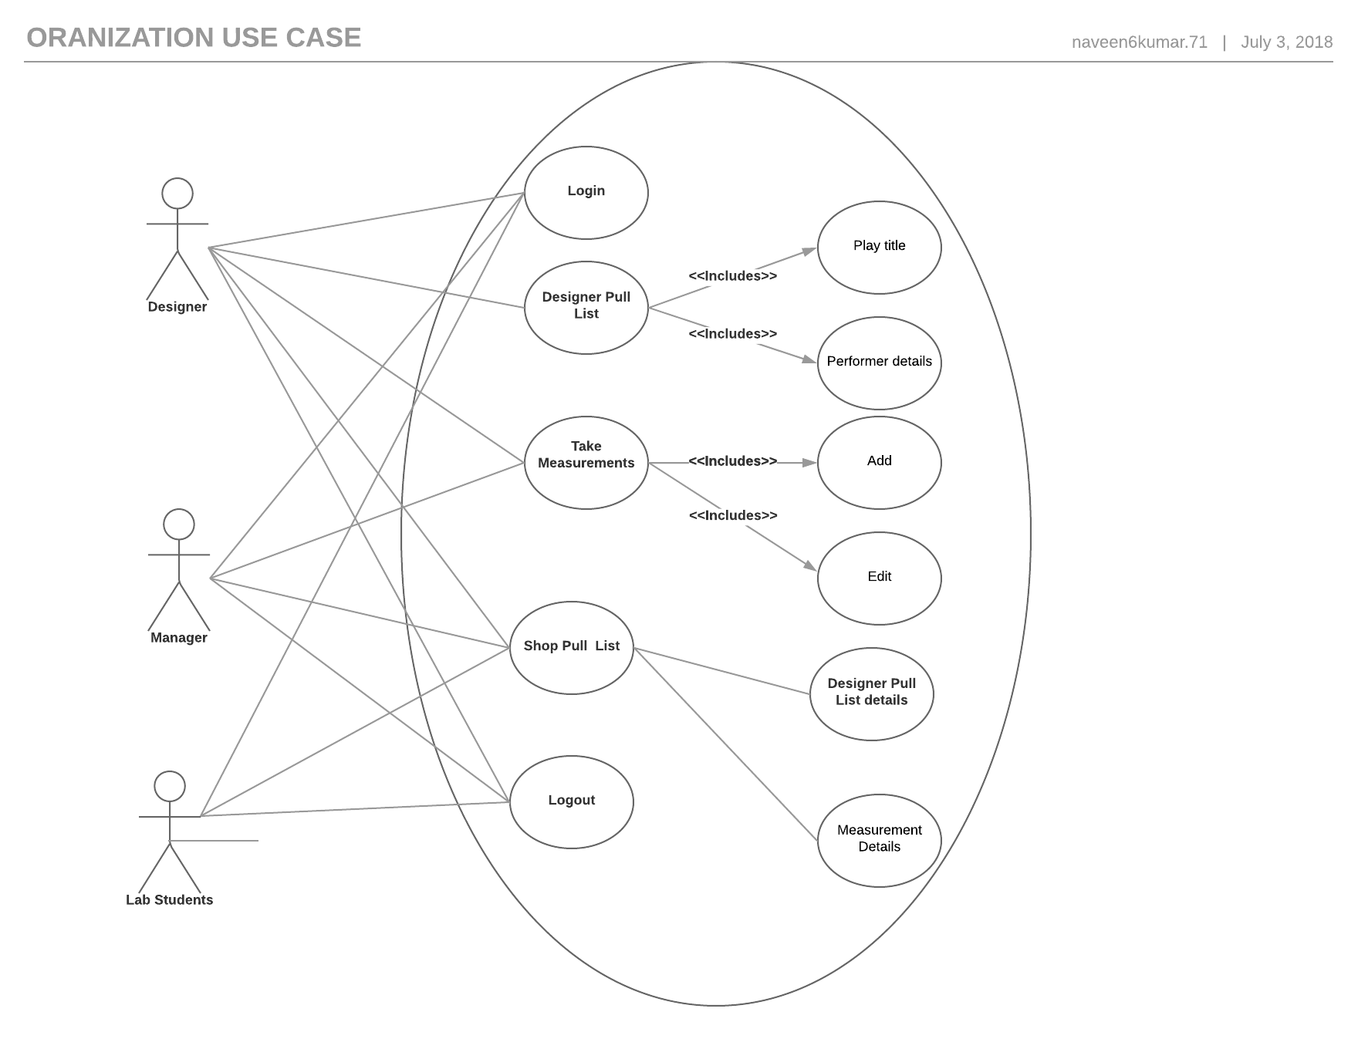
Organization use case
Meghana Mayaluri
Notes:
In this, every member has access to the website through a login portal and there are different levels of access the organization information.
Designer only have access to the design pull list information which consists of play title and performer details.
Designer have access to add and edit the measurements of performers. While the rest of organization members have only view and add access.
Every member in the organization has access to shop pull list.

Slide 9
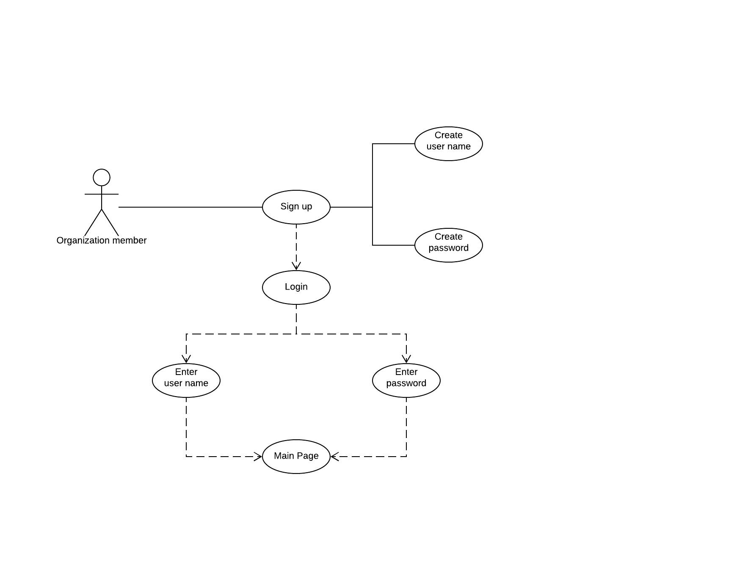
Sign up
Every organization member first create their user name and password to login to the website.
Meghana Mayaluri

Slide 10
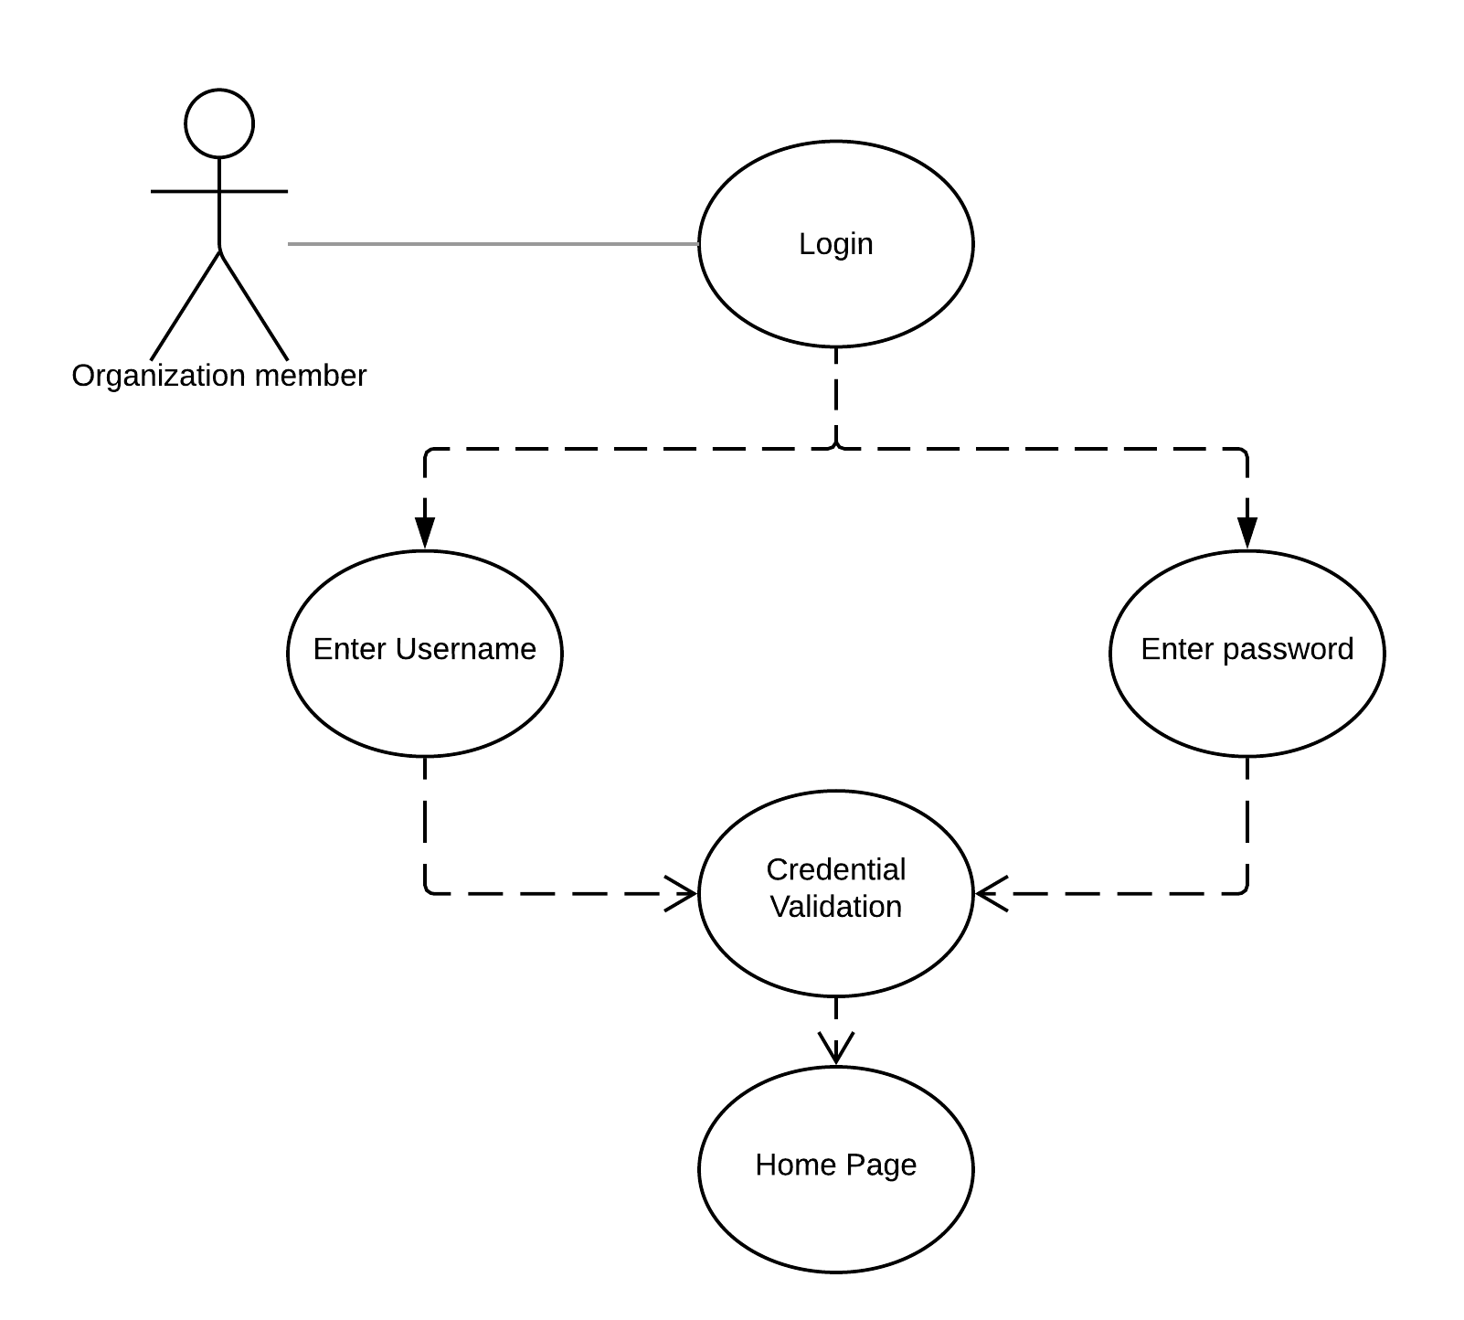
Login
Every organization member enter their login credentials to have a view of costume designing home page.
Meghana Mayaluri

Slide 11
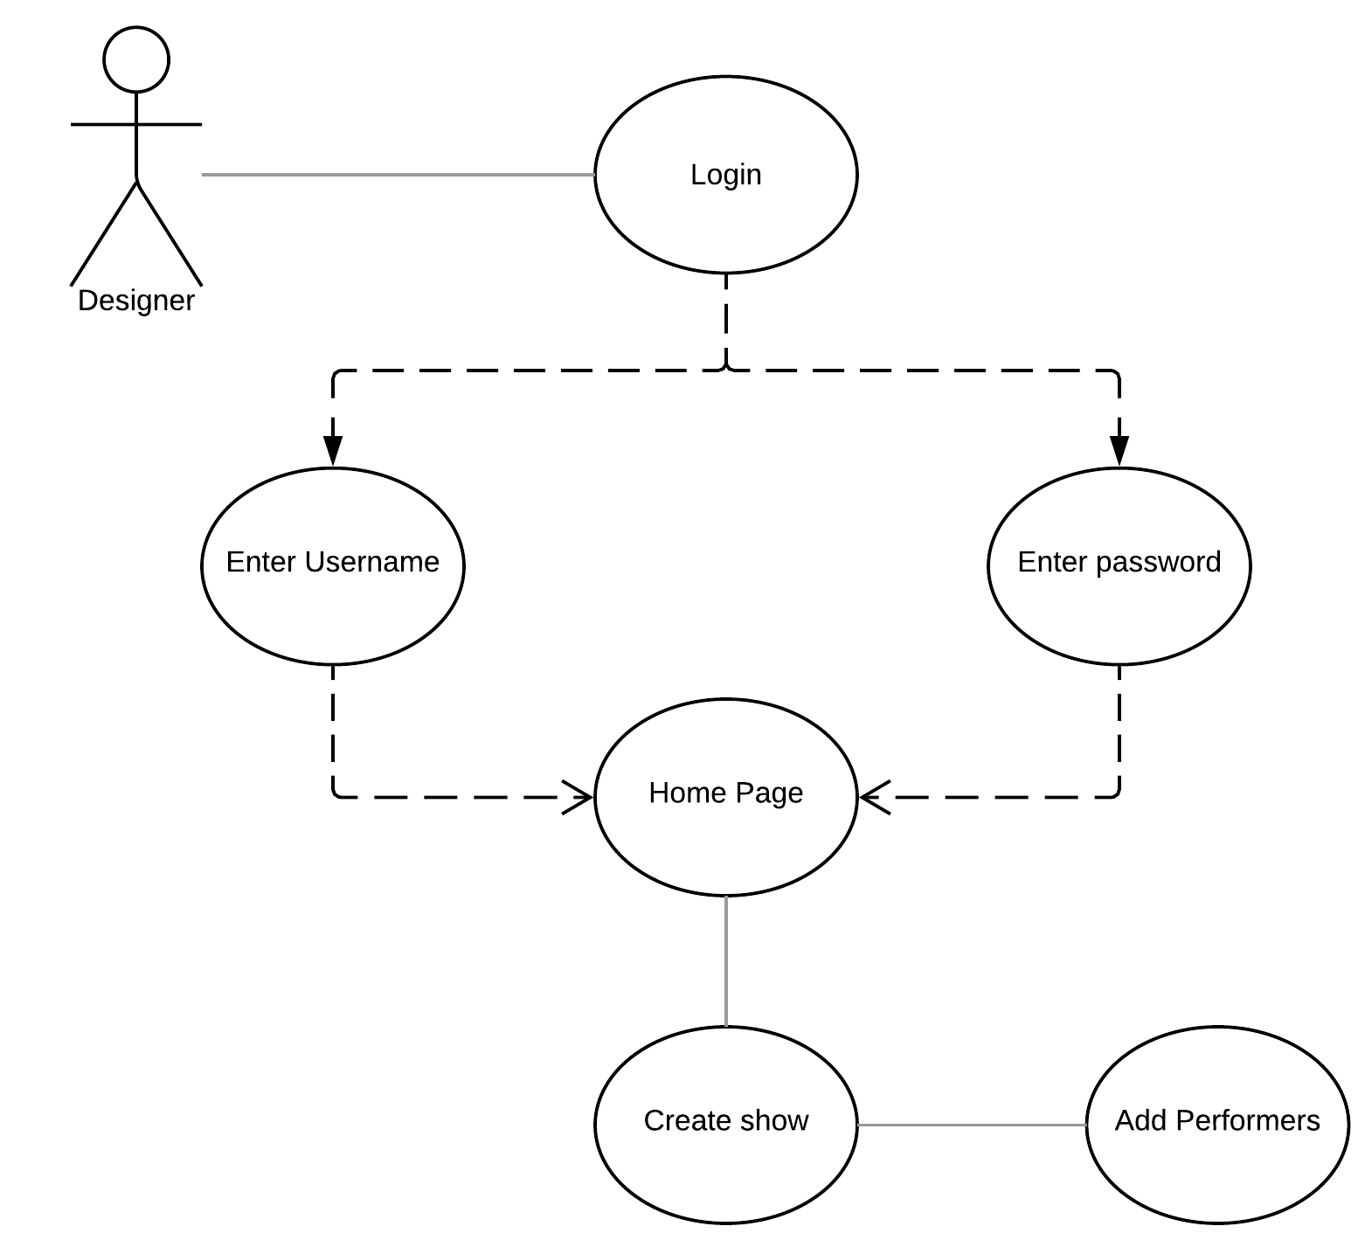
Create show
Naveen Kumar Puvvada

Slide 12
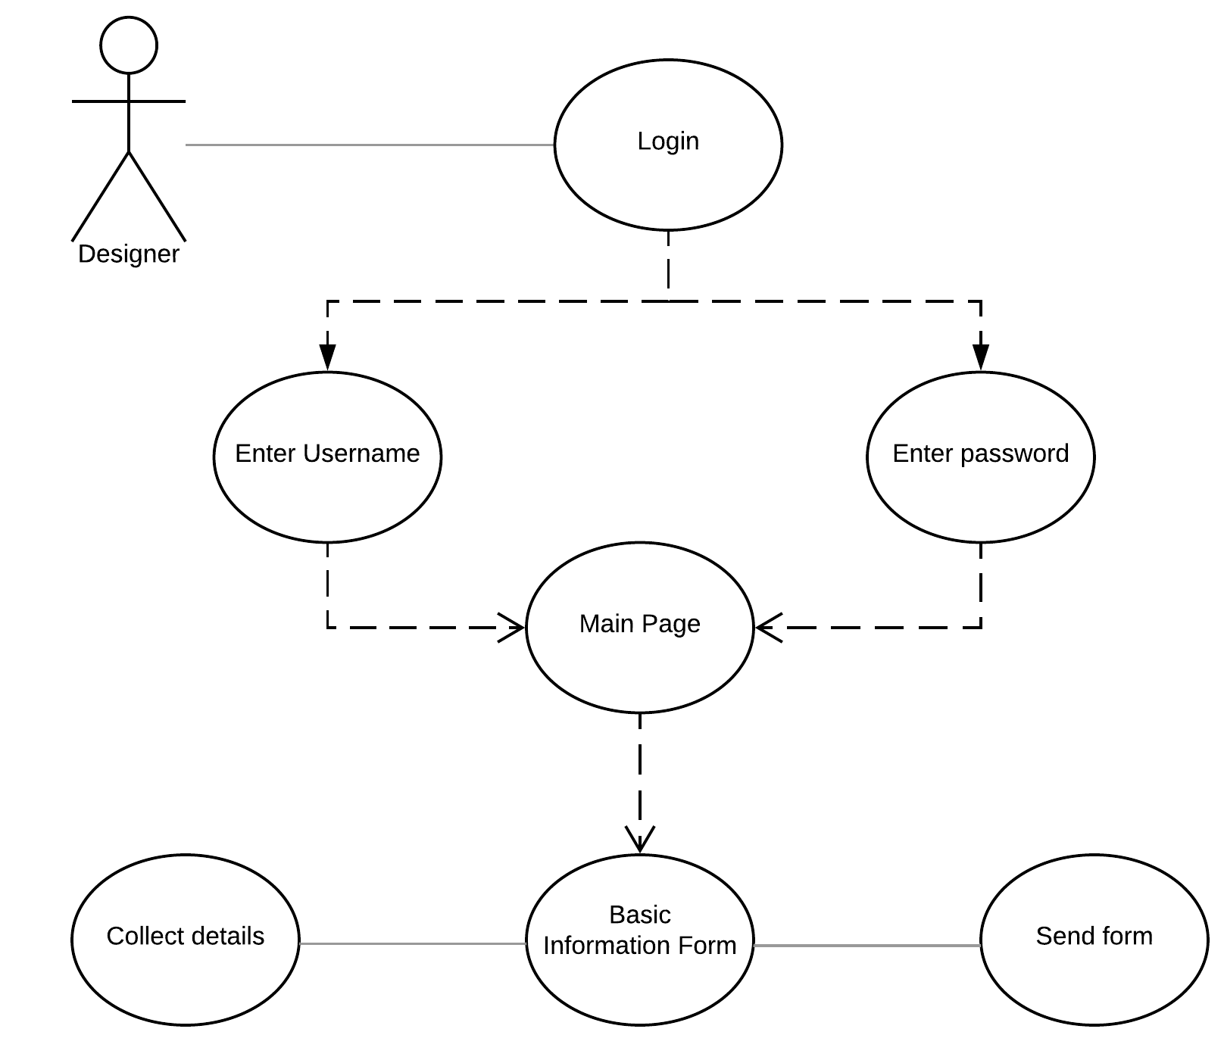
Basic information form
Designer has the access to send the basic information form of a performer performing in a play.
Naveen Kumar Puvvada
Notes:
The collected information is stored by system to create dashboard on our website.

Slide 13
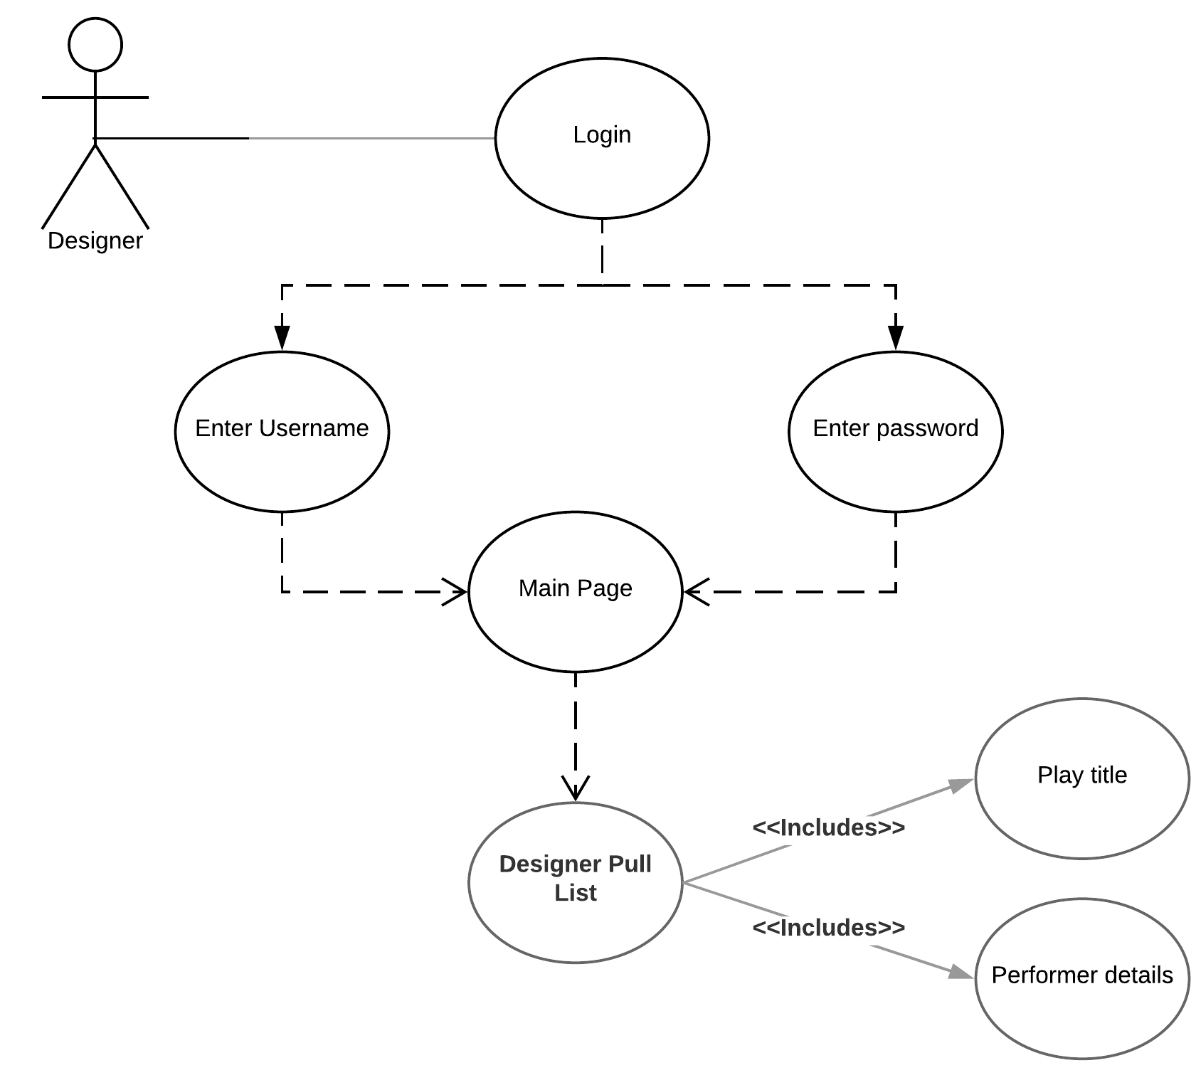
Designer pull list
Designer will log in to the system to get a view of what projects are going on for this month and who are the performers and their details for the play.
Naveen Kumar Puvvada

Slide 14
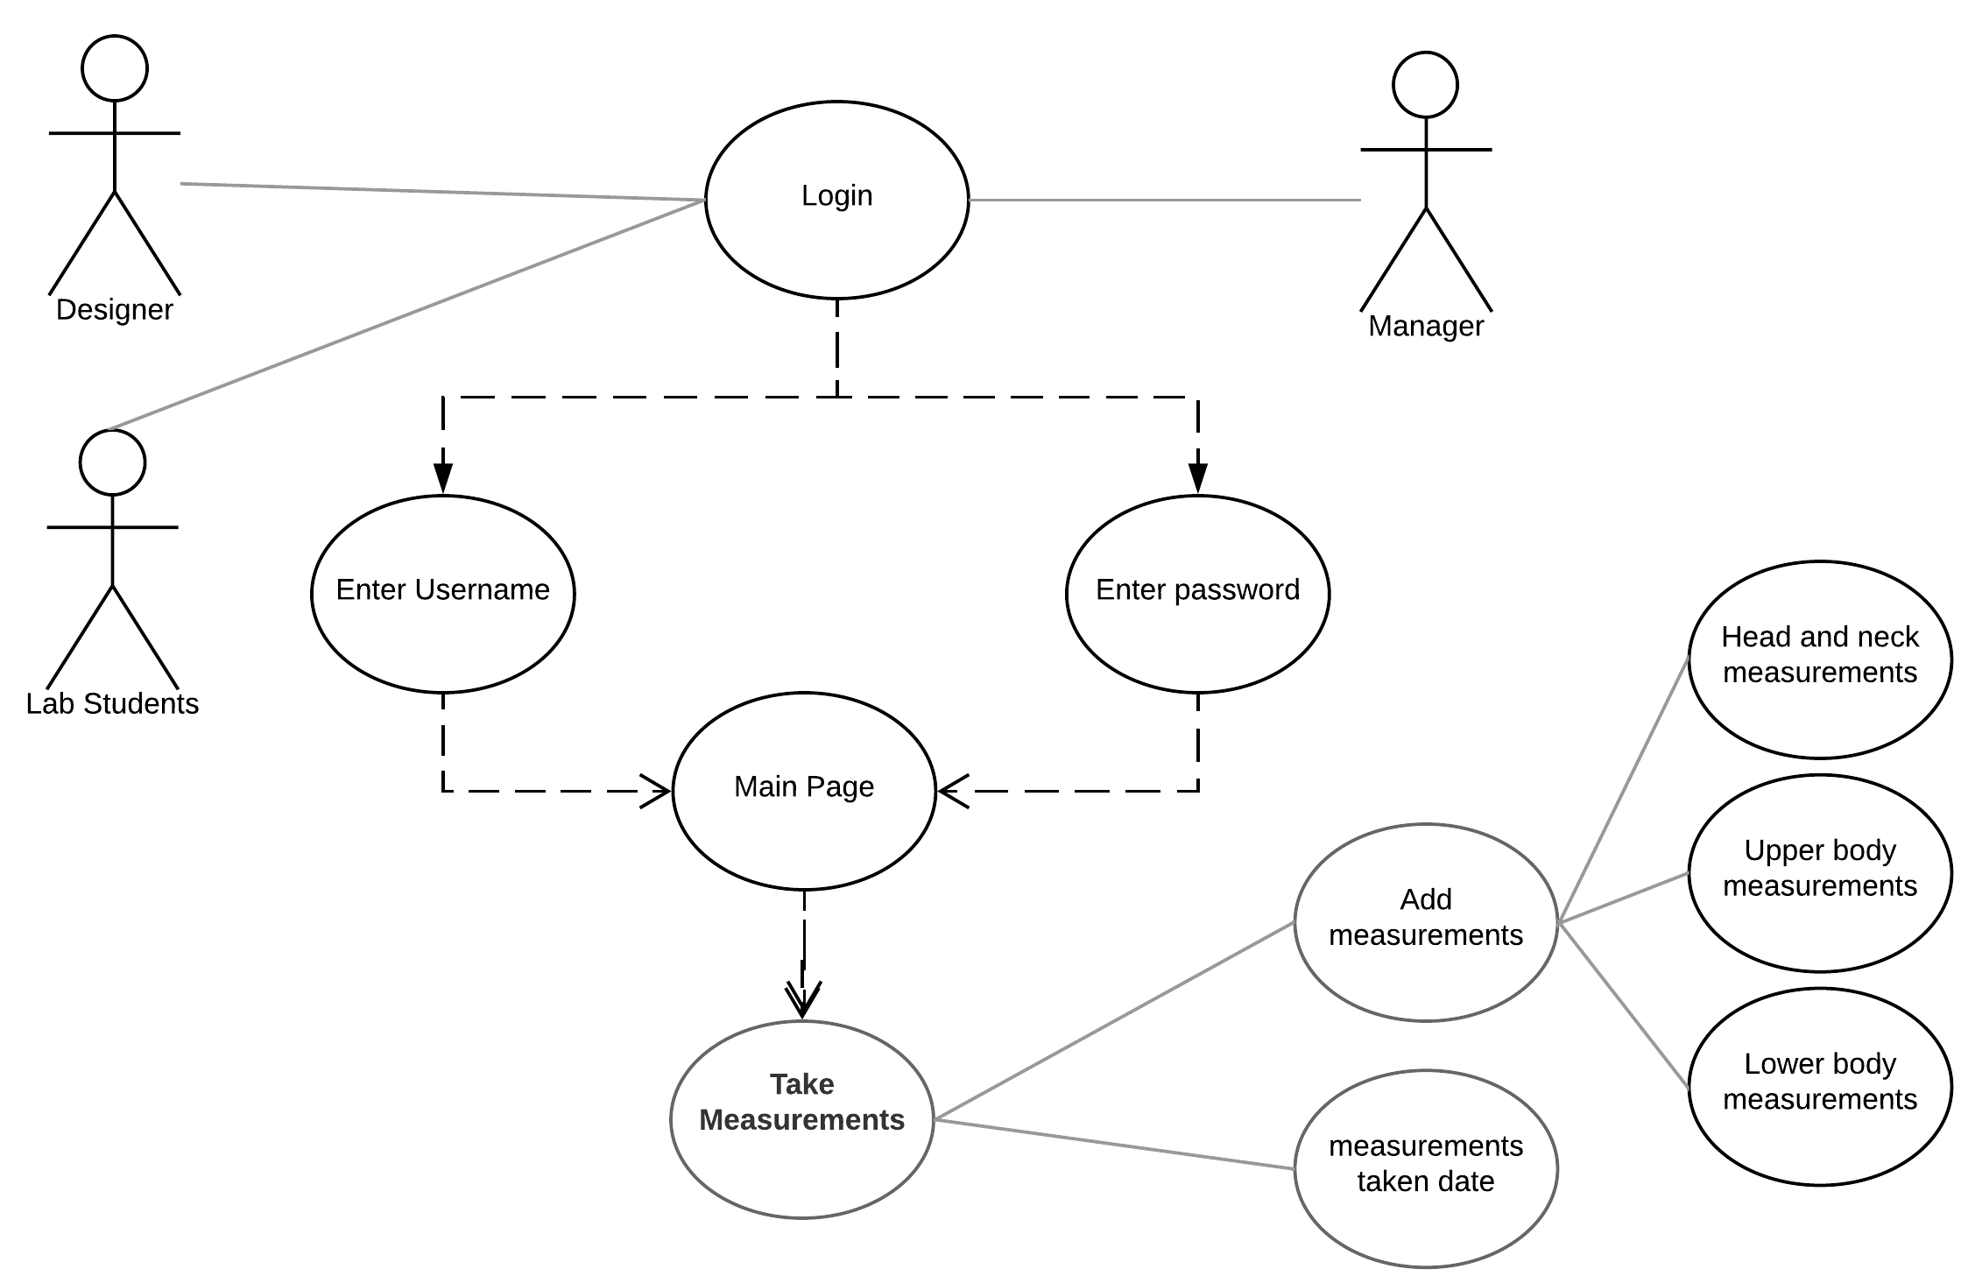
Performer measurements
Naveen Kumar Puvvada
Notes:
Every member(Designer, manager, lab students) in an organization will log in to the system to get a view of what projects are going on for this month and who are the performers and their details for the play.
Designer, manager, and lab students have access to view and take a performer's measurements in a play.

Slide 15
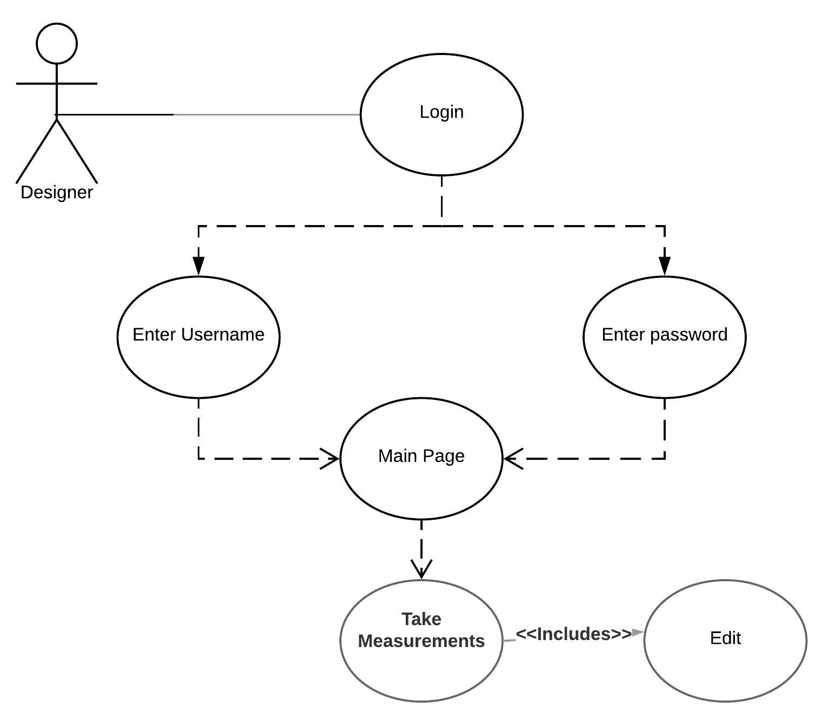
Edit measurements
Designer only has the admin access to modify the measurements of a performer.
Naveen Kumar Puvvada
Notes:
Here, the admin only can edit the measurements which were taken by the designer or manager or lab students. If there is an error in the measurements taken, they had to report to the admin, s that the admin can correct those measurements.Designer only has the admin access to modify the measurements of a performer.

Slide 16
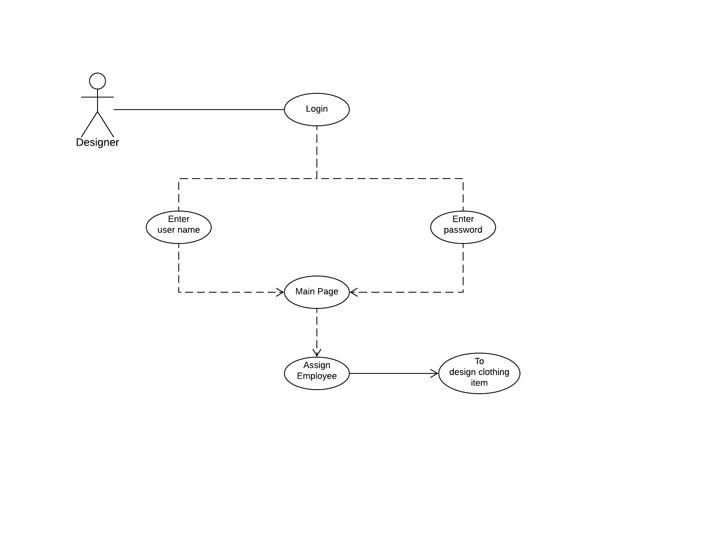
Assign employee
Naveen Kumar Puvvada
Notes:
In this use case, the admin can assign an employee to a particular project.Designer assigns an employee for designing a clothing item of a performer in a play through this tab and checks the progress of the clothing item.

Slide 17
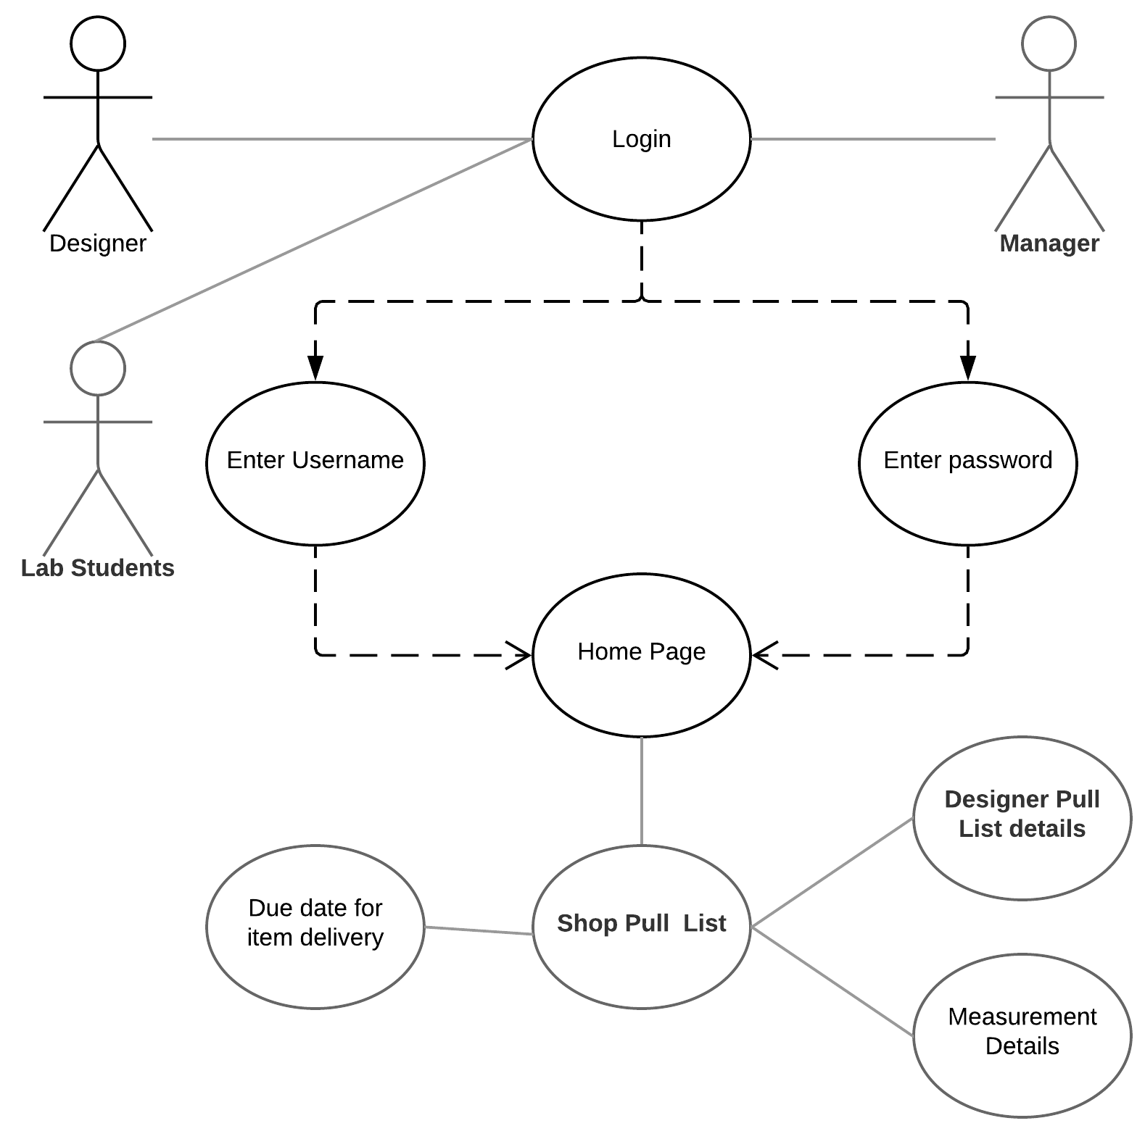
Shop pull list
Naveen Kumar Puvvada
Notes:
Manager,labstudent,designer can login into pull list but they can’t be able to edit those pull list.They can just check the whether items for designer and particular measurement clothing for an actor are available or not.Every member in organization has access to shop pull list information which consists of partial designer pull list information without edit access and also particular clothing measurements of a character for play.

Slide 18
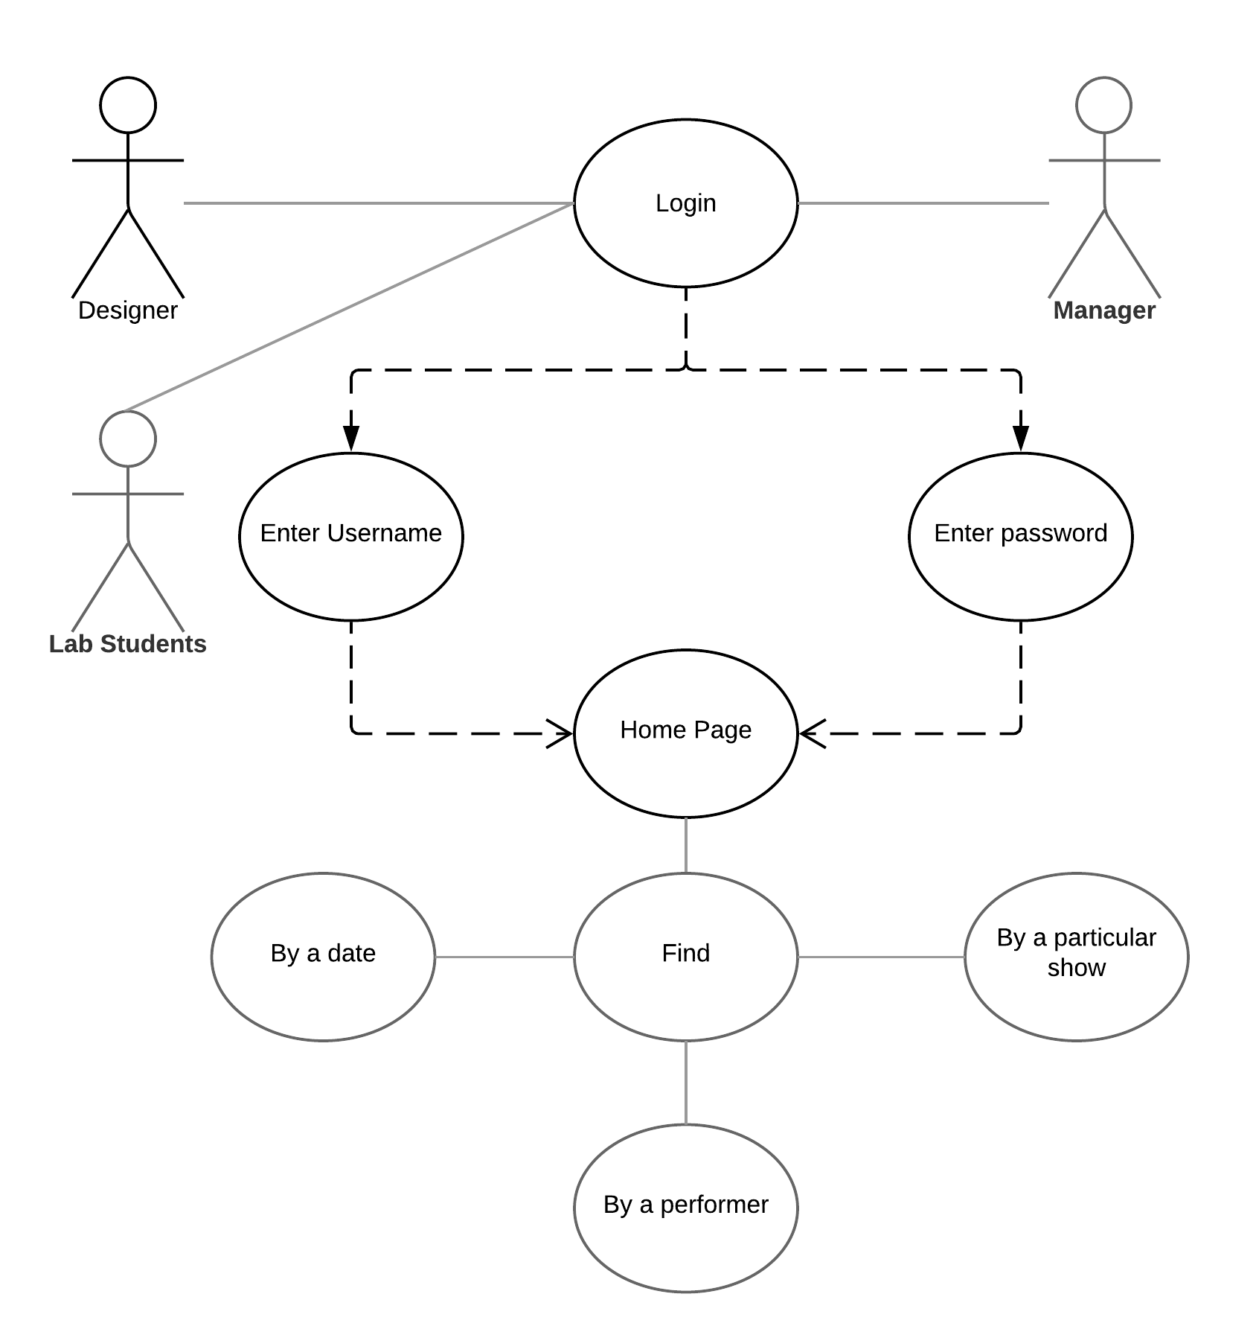
Find option
Naveen Kumar Puvvada
Notes:
Every member in organization can select the date view option for getting information on who are performing play on that day.
Every member in organization can select a particular show to know who are performer in that play.
Every member in organization can select a performer to get his complete details like what plays he performed and in performing.

Slide 19
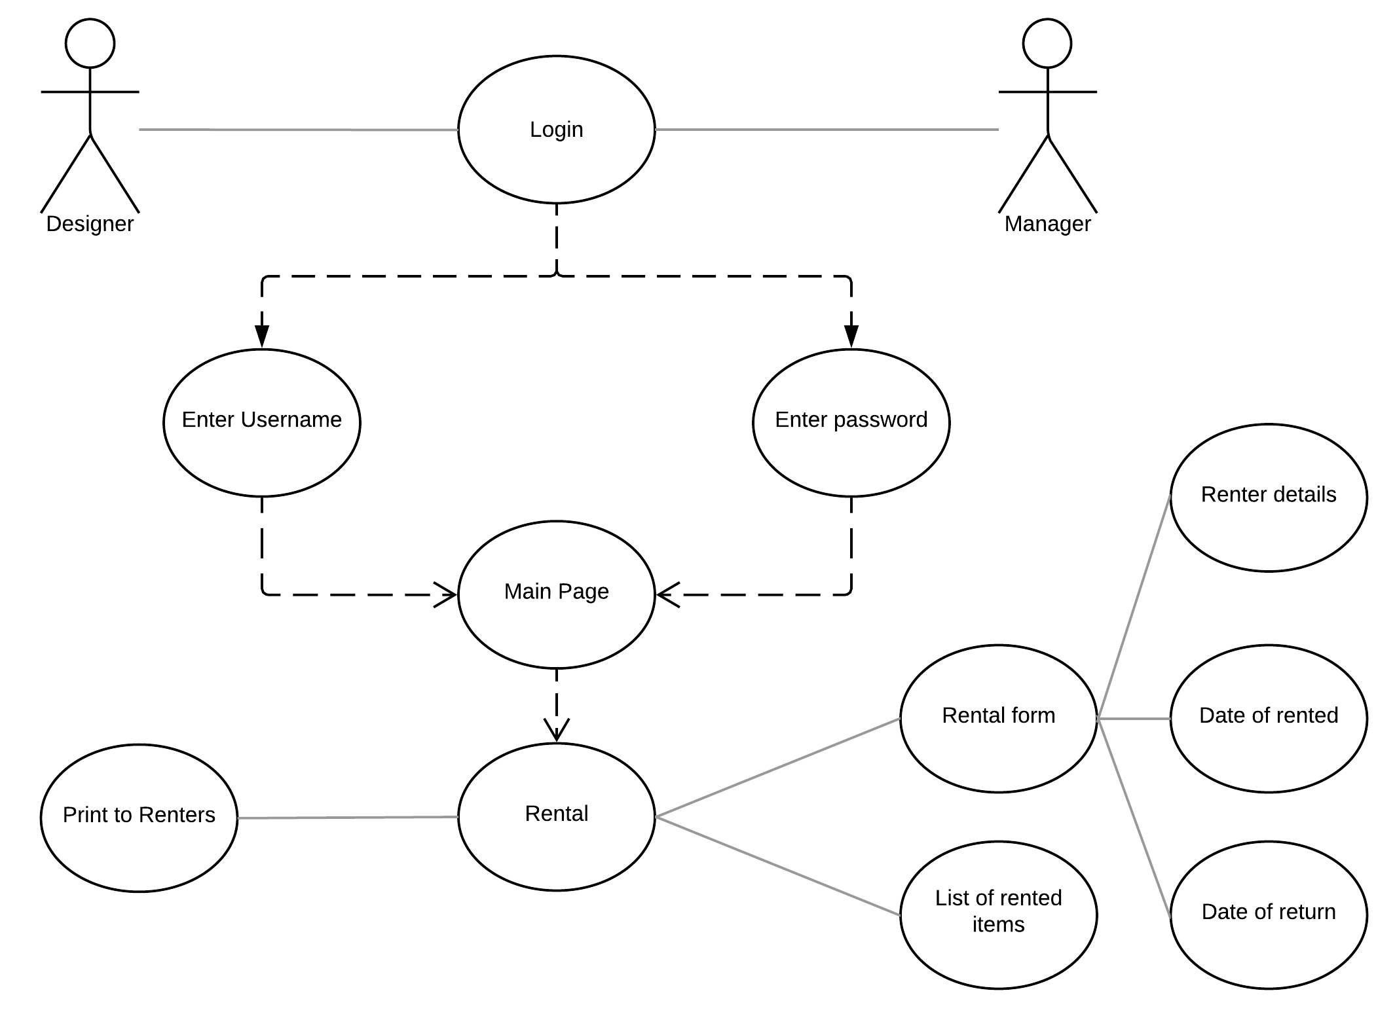
Rental
Venkata Siva sai Nadipeneni
Notes:
Designer and manager have access to rental information tab where they can fill in the rental form which consists of the rented costume details, their date of rented and date of return.
They also have an list in for the organization to view what items are rented.
They also have an print option for the rented form to give the detailed list to rental persons.

Slide 20
Data management plan
We are using Mongodb to store our data.
Data to be stored:
Employee details
Play details
Performer details
Shop pull list
Rental details
Venkata Siva sai Nadipeneni
Notes:
This data management plan is to store details of an organization employees,list of items required for design,measurements of each individual customer in a database. We can also store designer’s and performer’s information along with the type of play the performers are going to play.

Slide 21
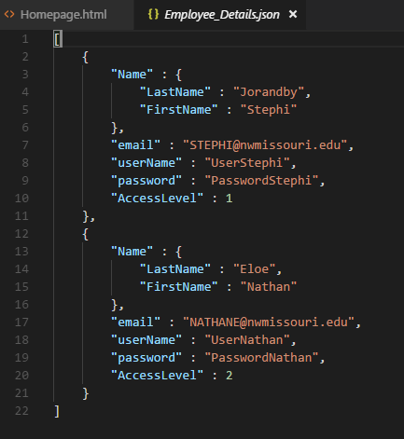
Employee details
Venkata Siva sai Nadipeneni

Slide 22
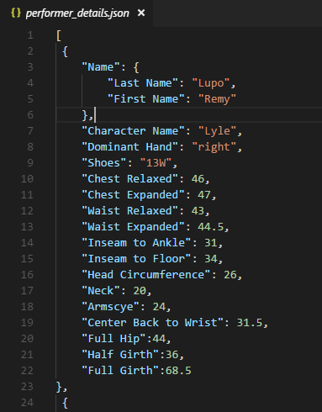
Performer details
Venkata Siva sai Nadipeneni

Slide 23
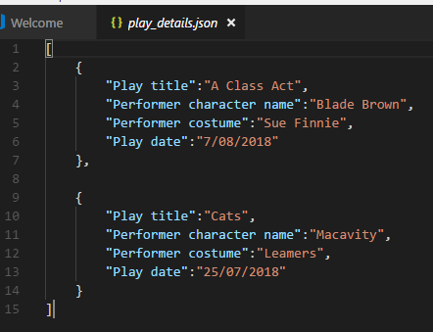
Play details
Venkata Siva sai Nadipeneni

Slide 24
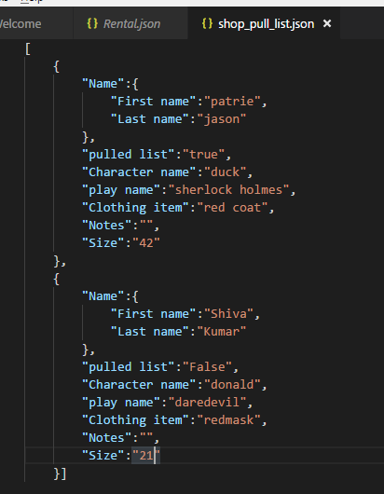
Shoppull list details
Venkata Siva sai Nadipeneni

Slide 25
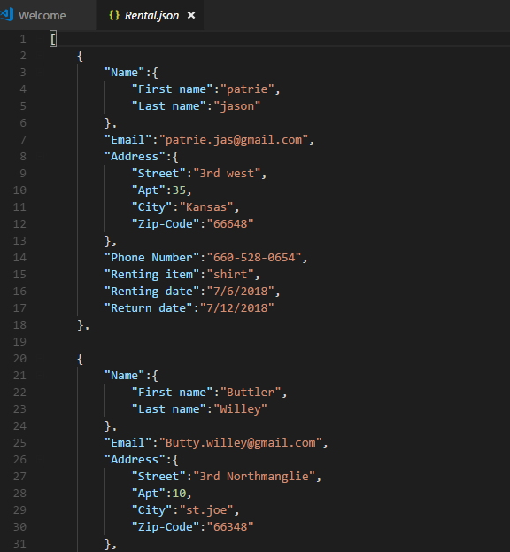
Rental details
Venkata Siva sai Nadipeneni

Slide 26
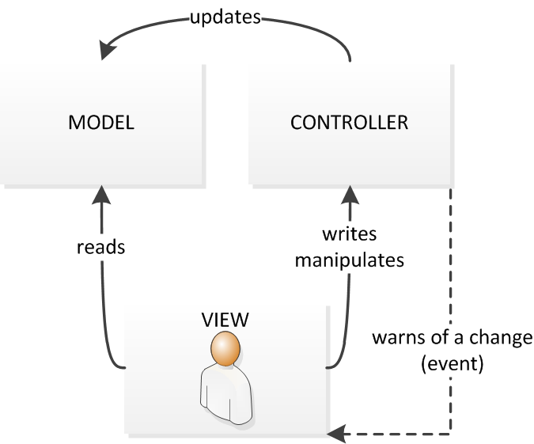
Architecture plan
Venkata Siva sai Nadipeneni
Notes:
https://fr.wikipedia.org/wiki/Mod%C3%A8le-vue-contr%C3%B4leur

Slide 27
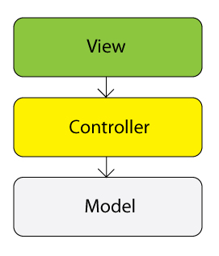
Design patterns
View: The stuff for displaying whatever it is that you are supposed to be displaying in the application
Controller: The bit that connects the view and model
Model: The classes that model the domain or subject matter for which you are writing software
Venkata Siva sai Nadipeneni
Notes:
http://javaphpmysql.blogspot.com/2012/12/java-mvc-model-view-controller-design.html

Slide 28
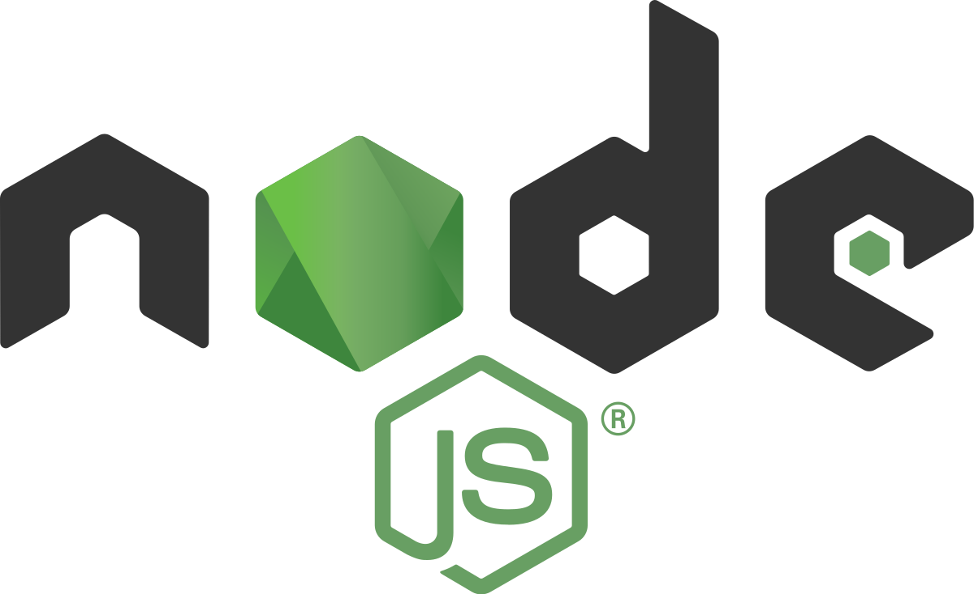

Platforms and technologies
A web application can be used for managing the costume design to maintain and organize the performers data.
Platform: Node JS
Technologies: HTML, CSS, Bootstrap
Venkata Siva sai Nadipeneni
Notes:
http://compacttechnologies.net/2018/03/important-of-web-application-development-for-enterprises/
https://www.beeva.com/beeva-view/desarrollo/test-unitarios-node-js-proxyquire-sinon/

Slide 29
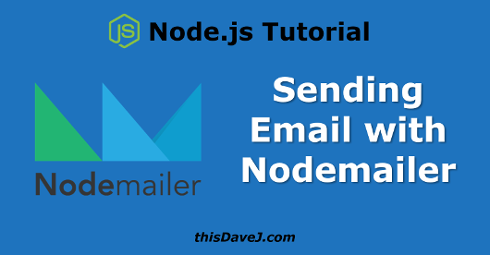
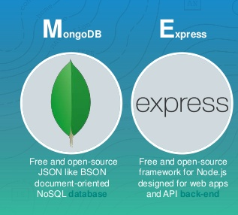
Third party libraries
Nodemailer: We are using this library for sending mails to performers
Express: Node JS framework for creating API’S.
Passport: This is used to authenticate login credentials.
Akhil Ravipati
Notes:
http://thisdavej.com/node-js-sending-email-notifications-using-nodemailer-and-gmail/
https://codecondo.com/express-js-frameworks-its-time-to-give-them-a-try/

Slide 30


Hosting strategies
Heroku
Amazon web services
Akhil Ravipati
Notes:
https://spin.atomicobject.com/2018/05/15/extending-heroku-timeout-node/
http://www.americancsm.com/secure-devops-aws-instance-creation-via-automation-vs-golden-amis/

Slide 31

Security plans
Password security by hashing
Bcrypt hashing technique
Validating the user input text fields
https://goo.gl/images/75gezM
Akhil Ravipati
Notes:
We want to store the passwords securely by hashing the password rather than storing it in plain text. We have found some hashing techniques like bcrypt which uses blowfish hashing algorithm with modifications to hash the password. It has two interfaces classic hashing algorithm technique and key derivation function intended for generating keys.

Slide 32
DEMO
UI Mockups
Akhil Ravipati
Notes:
https://goo.gl/images/eQLGRu

Slide 33
DEMO
Functional Prototype
Shiva Mutukula
Notes:
https://goo.gl/images/eQLGRu

Slide 34
Conclusion
The current system has the flaws
Requirements gathering and analyzing the problem
Web application using node as a solution
Modifications by client review
Shiva Mutukula
Notes:
The current system using for costume designing has flaws that we just discussed and is ineffective. Based on the requirements provided by the client and analyzing the problem, we have come up with a solution to have an web application using node. We want to implement the prototype that we designed. Any further modifications can be done by the client reviews

Slide 35


Notes:
https://www.jumpartmedia.com/website-design-company-intake-form/#.WzWCEqdKjIU
https://www.shutterstock.com/search/any+questions

